Slide 1

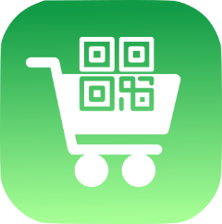
CLup: Customers Line-up
Advisor: Prof. Matteo Giovanni Rossi
Students: Alessandro Nocentini
Alberto Valentini
Fausto Luca Pichierri
M.Sc. Automation and Control Engineering
Software Engineering (for Automation)
Academic year 2021/2022

Slide 2

Clup: scope
Enable Store Managers to regulate the influx of
people in their store
Avoid the creation of gatherings outside the
stores and crowds inside them
Allow customers to save time booking their ticket
from home instead of wasting time in queues

Slide 3
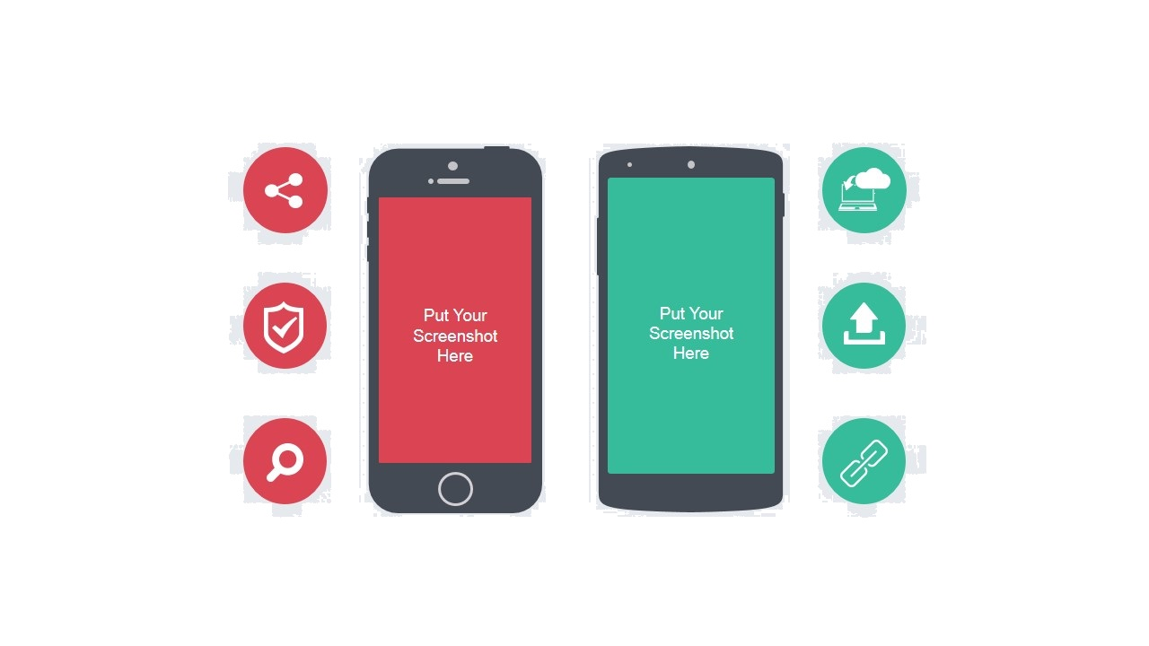
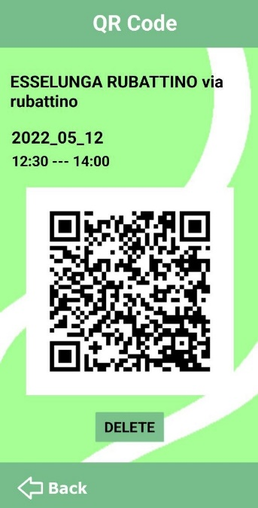
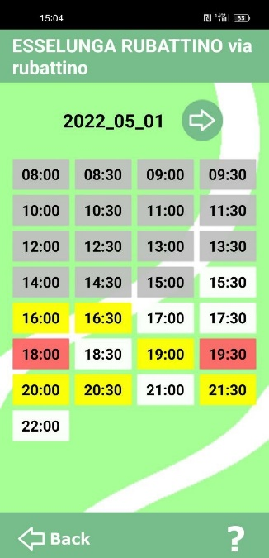
CLUP: FUNCTIONALITY
1
3
LOG-IN AND SIGN-UP
BOOK THE TIME SLOTS
2
4
CHOOSE A SUPERMARKET
USE THE QR CODE

Slide 4
SOFTWARE LIFECYCLE
D1
D2
D3
D4
RASD
DESIGN DOCUMENT
IMPLEMENTATION
TESTING
Document containing a description of the requirements and the features of the app
Document which provide a functional description of the main architectural components of the system
It is presented a possible way to implement a prototype of the mobile phone application “Customers Line-up“
Verification and validation of the application

Slide 5
D1
RASD
Domain assumptions
Specific requirements
Product perspective
Sequence diagrams
Preliminary user manual
Software system attributes

Slide 6
D1
Specific requirement
They are divided in:
Functional requirements
Nonfunctional requirements
The functional requirements have been further separated into:
- Core
- Medium
- Good to have
based on their importance in the app working.

Slide 7
D1
Specific requirement- Functional (core)
R1: The system must allow users to sign up if and only if they are not already
registered.
R2: The system must allow users to sign in if and only if already registered and the
credentials inserted are valid.
R3: The system must allow the user to log out.
R4: The system must allow the user to search for and select the supermarket.
R5: The system must allow the user to choose the city.
R6: The system must restrict the supermarket research to the ones that are in the user city.
R7: The system shows time slots of the selected market according to the timetable
and crowding data.
R8: The system must allow the user to select the day on which they want to book in the
selected supermarket, among the ones that the store manager makes available.
R9: The system allows the user to make a reservation only in free time slots.
R10: The system must generate one and only one ticket per reservation.

Slide 8
D1
Specific requirement- Functional (core)
R11: The system must update the time slot crowding of the supermarket for each ticket
created/deleted in that store.
R12: Each ticket generated by the system must have a unique QR code.
R13: The system allows the user to make a reservation over more time slots only if
they are all free, consecutive and in the same day.
R14: The system allows the user to make a reservation only if it does not contain time slots
already involved in existing reservations at the selected market on the same day.
R15: the system must not allow the user to have concurrent reservations over a
maximum number.
R16: The system must allow the user to check their pending tickets.
R17: The system must allow the user to delete their pending tickets.
R18: The system does not allow the user to change single settings of already generated
tickets.
R19: The system must automatically delete the ticket at the end of its reservation time.

Slide 9
D1
Specific requirement- Functional (not core)
Medium priority
R20: The system should allow the user to update their data and delete their account.
R21: The system should allow the user to auto-log in if they have previously ticked a
“Remember me” box.
R22: The system should allow the user to recover their credentials.
R23: The system should alert the user when their account is created/deleted.
R24: The system should filter supermarkets by name.
R25: The system should remind the user about incoming reservations before their beginning.
Good to have
R26: The system should allow the user to select the app language.
R27: The system should allow the user to contact the assistance.
R28: The system should allow the user to download the QR ticket to use it offline.
R29: The system should show the recent supermarket researches.
R30: The system should memorize the favourite supermarkets.

Slide 10
D1
Specific requirement- NonFunctional
The system should be able to manage a high number of concurrent requests: depending on the cities size supported, one value could be a minimum of 1000 simultaneous users.
The app should be as lightweight as possible and guarantee fast time responses.

Slide 11
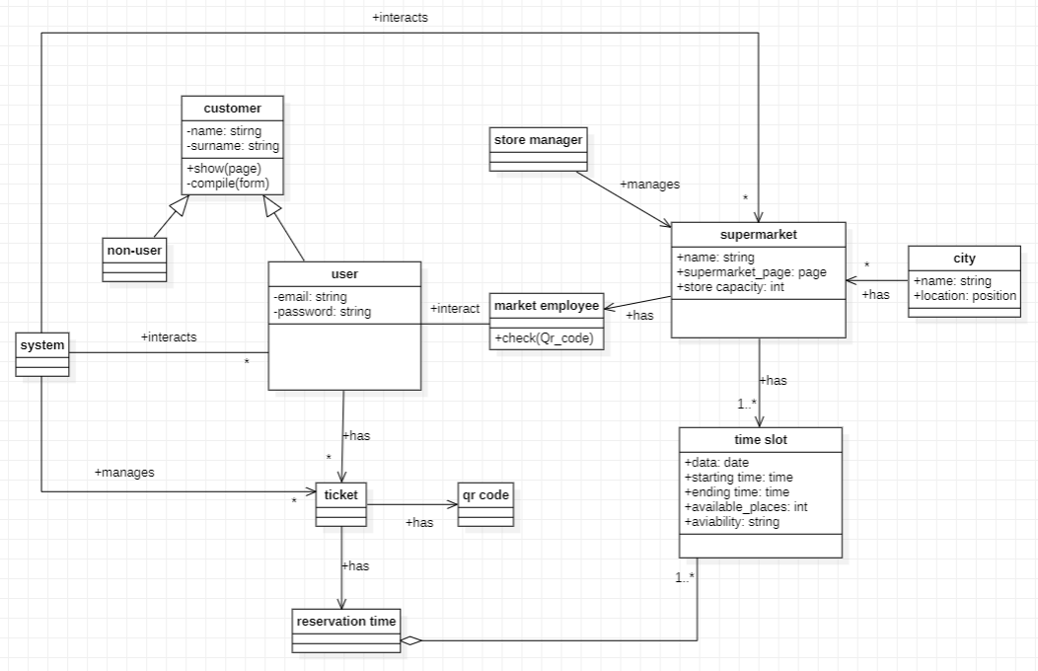
D1
Product perspective

Slide 12
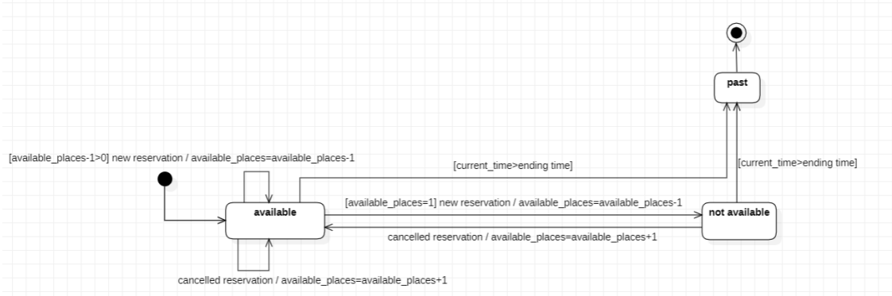
D1
Product perspective
Time slot availability

Slide 13
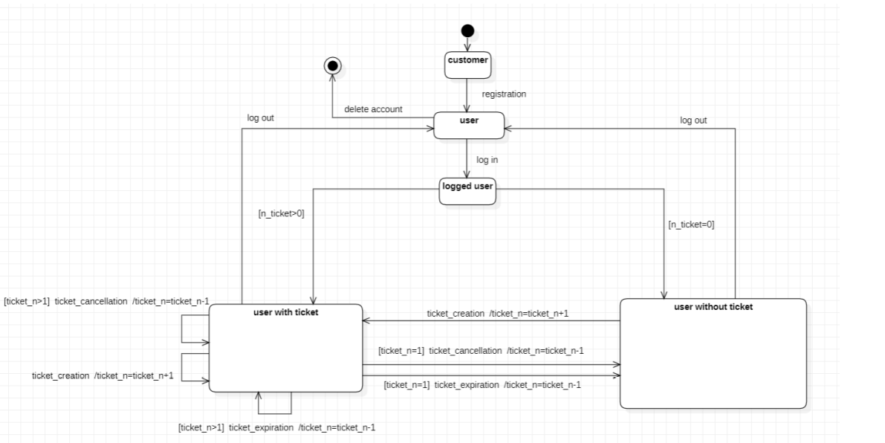
D1
State diagrams
User’s state evolution

Slide 14
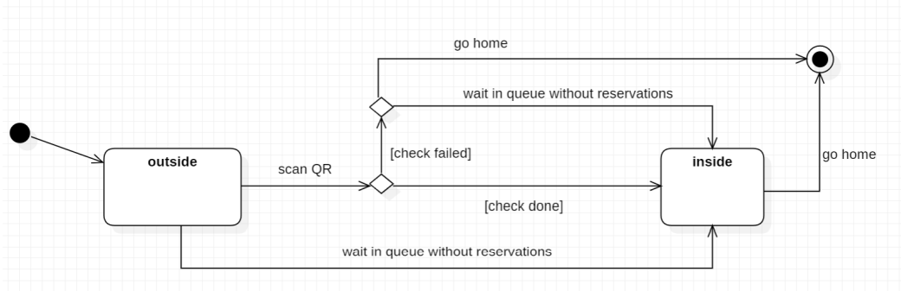
D1
State diagrams
Shopping scenario

Slide 15
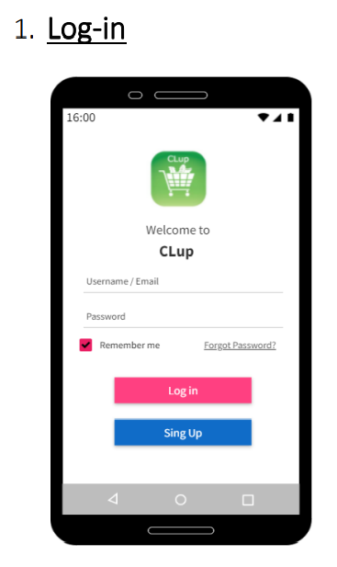
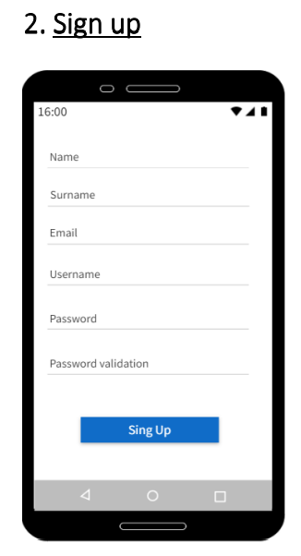
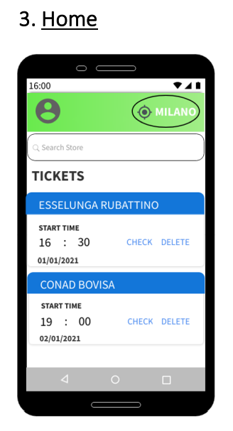
D1
Preliminary user manual

Slide 16
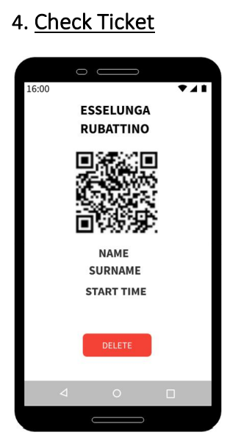
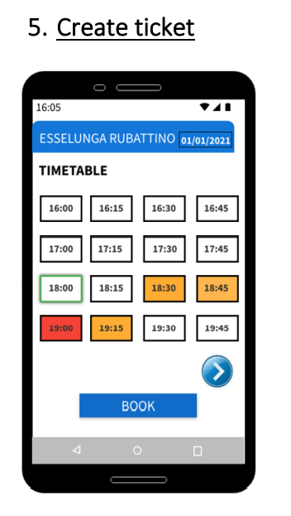
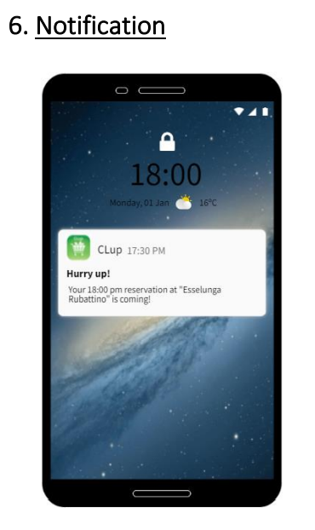
D1
Preliminary user manual

Slide 17
D1
Software system attributes
Reliability:
The system is required to be robust and able to face potential faults that could happen, in order to guarantee the continuity of the service.
Availability:
Because the application is designed for grocery stores, which might be open 7 days per week and sometimes 24h, it should guarantee a similar availability.
Security:
The system does not use sensitive data but would be good to have a technology that guarantees the protection of the user’s data against intrusions from non-authorized people.

Slide 18
D1
Software system attributes
Maintainability:
The system should be designed following a modular approach so that possible errors will be confined in stand-alone modules and facilitating correction and updates. The maintenance should be made during the periods when the service is less used, like during nights or holidays, and an alert should be sent to the users the day before.
Portability:
The application should be available for most Android and iOS devices in order to reach its goal of widespread usage.
Usability:
The application should be used by any range of ages, so it should have a simple and intuitive user interface.

Slide 19
D1
D2
DESIGN DOCUMENT
Architectural Design
Component interfaces and Operations
Sequence diagrams
Graphical user interfaces
Requirement traceability

Slide 20
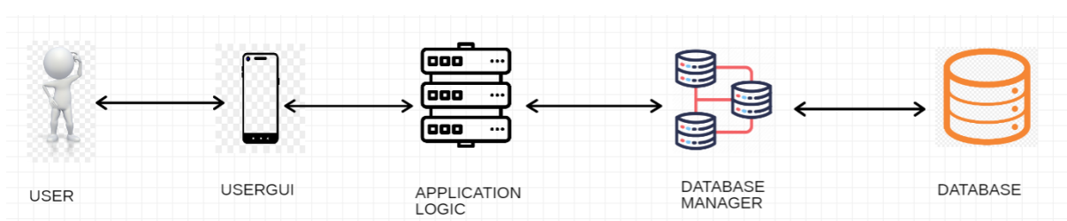
D1
D2
Architectural Design – high level

Slide 21
D1
D2
Architectural Design – high level
UserGUI:
Thanks to the graphical interface of the application installed on the User’s phone, he can take advantages of all the offered services.
Application Logic:
It is the main component of the system; it elaborates all the request coming from the application. It communicates with the Database manager to receive or store information and with external component like the Mail service
Database Manager:
It reads, writes and updates information, following the instructions given by the Application Logic. It is the only component which communicates with the Database.
Database:
It contains all the useful information related to the users and to the markets.

Slide 22
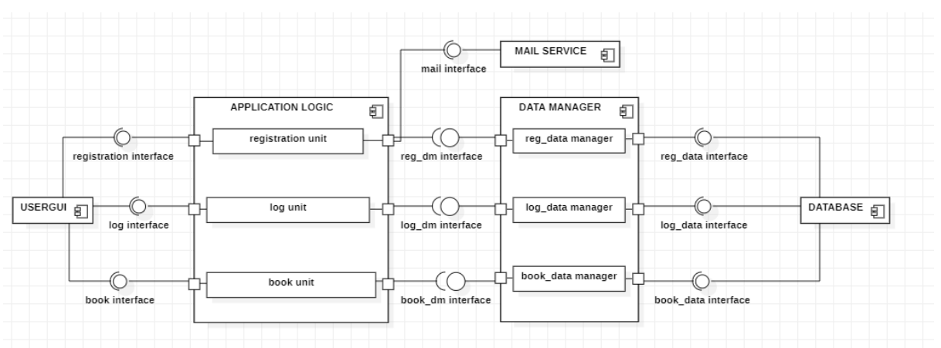
D1
D2
Architectural Design – component view

Slide 23
D1
D2
Architectural Design – Application logic
Registration unit:
It allows a new customer to sign up; it also makes a check on registration form and communicates with the mail system
Log unit:
It allows the user to sign in by checking the log in form; it also finds information related to the User’s city
Book unit:
It allows the user to create a new reservation, to generate the QR code, to cancel some tickets. It is also responsible to show the user the only available time slot and to update the timetable.

Slide 24
D1
D2
Architectural Design – Data manager
Reg_data manager:
It passes the users information to the ‘Registration unit’ when someone wants to sign up. It is also able to store modifications.
Log_data manager:
It gives to the ‘Log unit’ information related to the user that wants to sign in, like credentials and default city. It is also able to store modifications in the User data.
Book_data manager:
It gives to the ‘Book unit’ all the information that are needed when the logged-in user wants to make a reservation. It is also able to store modifications.

Slide 25
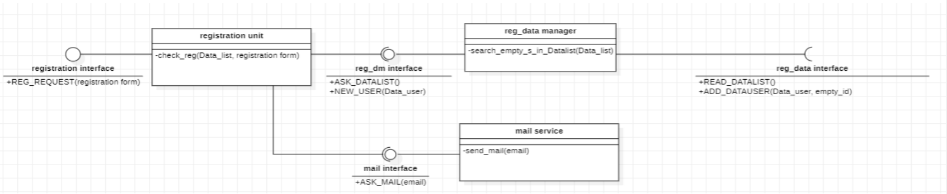
D1
D2
Component interfaces and operations
Registration system

Slide 26
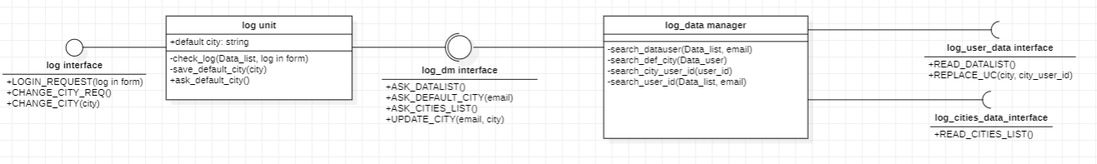
D1
D2
Component interfaces and operations
Log system

Slide 27
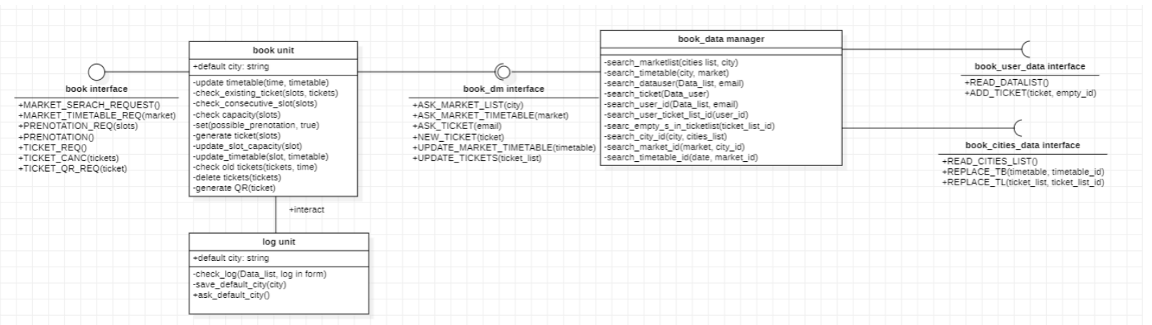
D1
D2
Component interfaces and operations
Book system

Slide 28
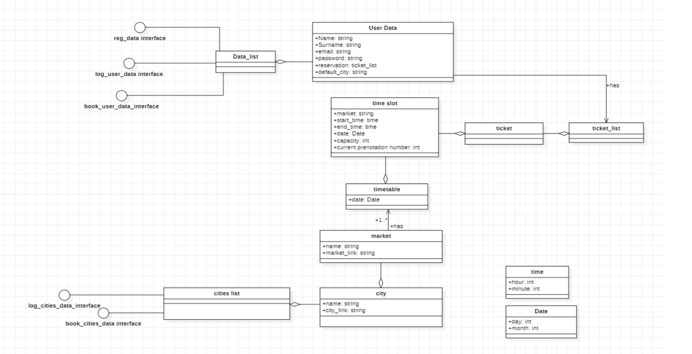
D1
D2
Database

Slide 29
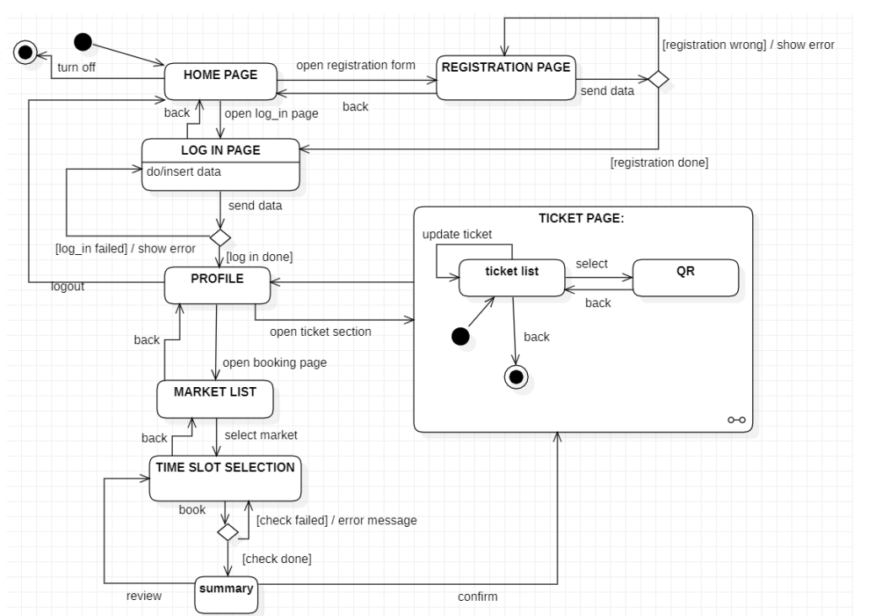
D1
D2
Graphical user interface

Slide 30
D1
D3
IMPLEMENTATION
System architecture
Clup application
Database
Database manager
Software system attributes
Requirement implementation: example

Slide 31
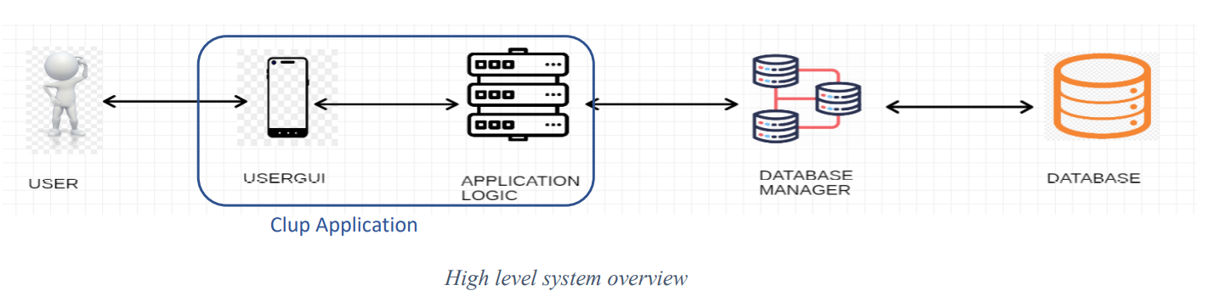
D1
D3
System architecture

Slide 32

D1
D3
Clup application – App Inventor
Clup application:
It processes the incoming request from the user and, when necessary, invokes the Database Manager to get/store data from/to the Database to fulfill the demand.
APP INVENTOR:
The CLup application has been developed for Android phones by taking advantage of the online framework "MIT App Inventor". App Inventor allows the creation of both Android and IOS applications in a quick and intuitive way owing to the availability of a wide range of ready-to-use objects and methods that the programmer just needs to code through a drag-and-drop approach.

Slide 33
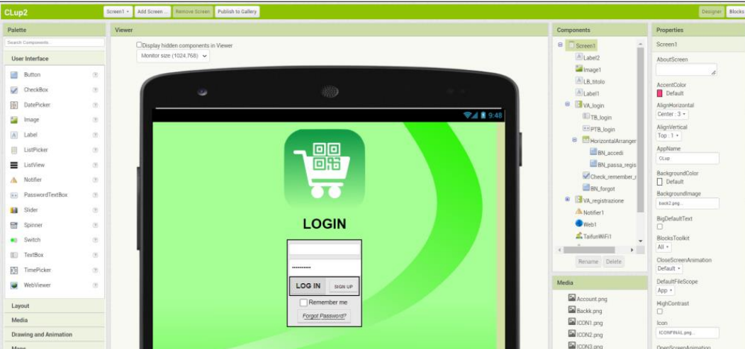
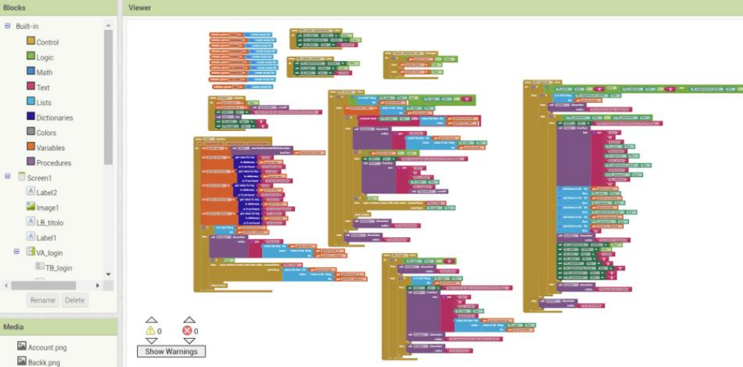
D1
D3
Clup application – App Inventor
App Inventor organizes the application in "screens": each screen represents a stand-alone module of the app dedicated to a specific service.
In the App Inventor environment, each screen is developed by using two sections:
Designer:here the user interface is designed, deciding which components the app must have and setting the layout
Blocks: this is the coding section. Here the programmer must set the components' behavior, the data processing and the interfaces for external communications
Designer
Blocks

Slide 34
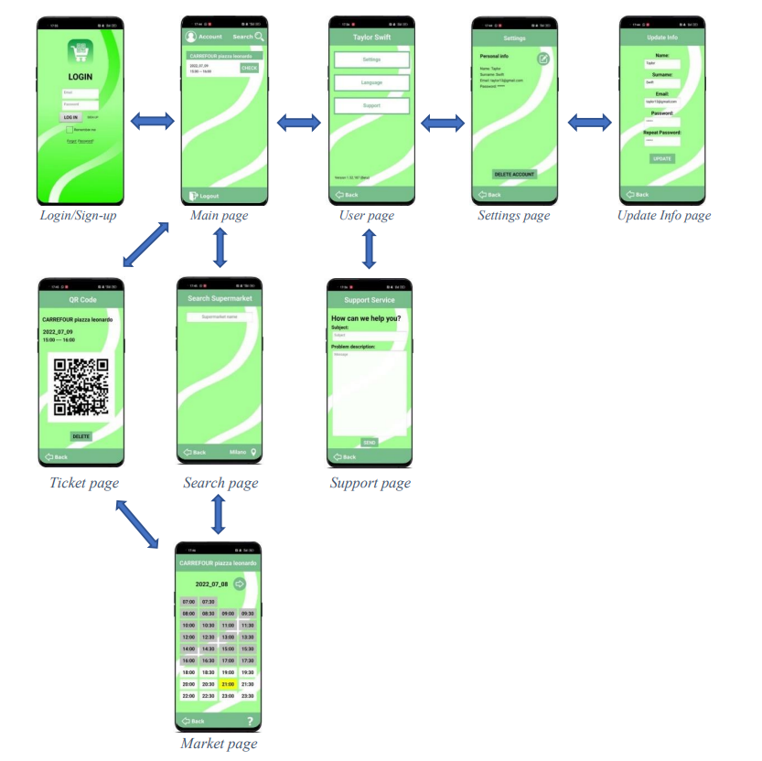
D1
D3
Clup application – App Inventor
General view of all the possible screens of the application and the flow to navigate between them.

Slide 35
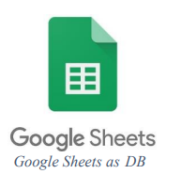
D1
D3
Database – Google Sheets
Database:
A database is a systematic collection of data. It contains the info needed for the proper working of the application. The application does not directly access the database but passes through the Database Manager System.
Google sheets:
As a database, in our prototype, we have used Google Sheets. They are free online spreadsheets and they have been chosen for their ease to use in combination with App Inventor and Google Apps Scripts, that will be used as DBMS.

Slide 36
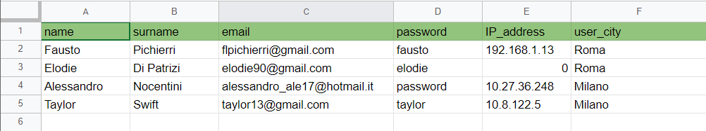
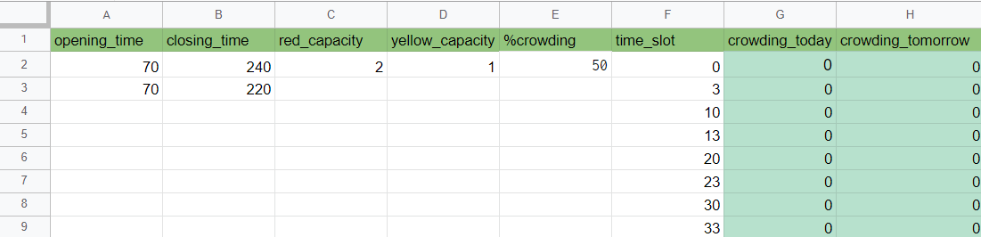
D1
D3
Database – Google Sheets
In our implementation, we did not use just a single Google Sheet as DB, but several Google Sheets depending on the nature of the data stored, so in a structure that resembles a distributed database; this way, it results easier handling a great amount of data and it improves the maintainability.
Account DB:
Market DB:

Slide 37
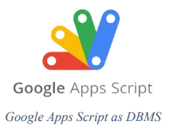
D1
D3
Database manager– Google App Script
Database manager:
The DBMS encompasses methods to manage the data in the Database and fulfill the client demand, such as returning data read from the DB or storing data in it. In this way, the information in the Database remains hidden from the application and its working does not directly depend on the way they are implemented in the DB.
Google app script:
Google Apps Script is basically JavaScript code, but with a wide library of functions to work with Google Sheets. In our system, they have the role of the Database Manager System.

Slide 38
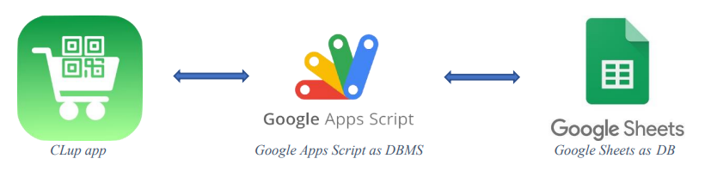
D1
D3
Database manager– Google App Script
Each Google Sheet has its relative Google Apps Script for reading the data, instead, there is only one Google Apps Script for all the Google Sheets for writing data, since, generally, a storing operation involves more Google Sheets.
The Google Apps Scripts are invoked by the CLup application using the App Inventor component "Web", which establishes an internet connection to execute the web application of the Google Apps Script.
The Google Apps Scripts return the database content as a JSON object. Then, the CLup application decodes it and takes only the information needed for that specific function.

Slide 39
D1
D3
Software system attributes – App Inventor
PROS:
- It allows the creation of the user interface in a visual way
-The coding is easy and intuitive owing to a drag-and-drop approach
CONS:
- It lacks in flexibility
- Poor code readability and portability
- It does not support background activities

Slide 40
D1
D3
Software system attributes – Google Sheets
PROS:
- They are free
- Easy to use in combination with App Inventor and Google Apps Scripts.
CONS:
- bad scalability
- not optimized database managing routines

Slide 41
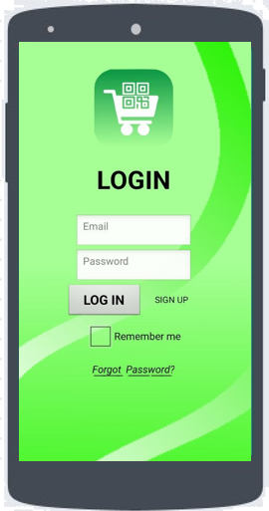
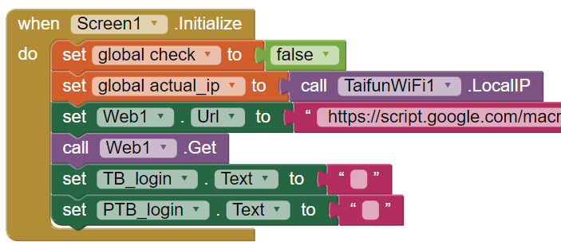
D1
D3
Requirement implementation: example
Here is given an example of requirement implementation.
SCENARIO: A new user wants to sign up and then log in → R1 + R2
When the user opens the CLup app,
the Login page is the first page shown.
When the page is initialized:
- The system gets the user's device IP address
- It sets the login form's fields blank
- "Web1" calls the Apps Script dedicated to
reading the Account DB

Slide 42
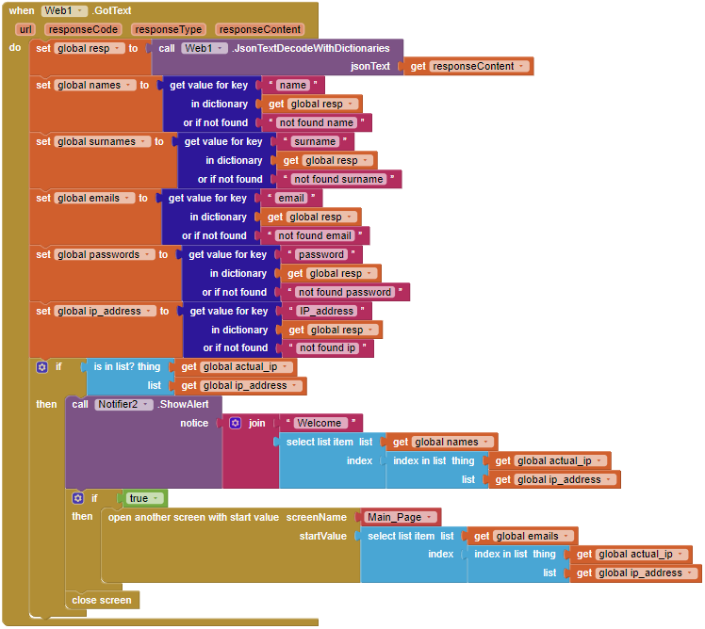
D1
D3
Requirement implementation: example
SCENARIO: A new user wants to sign up and then log in → R1 + R2
The Apps Script returns the entire content of the Google Sheet as a JSON object. The app just takes the info it needs filtering by header and stores them into variables
If the customer is already registered (it is not the case) and they have previously ticked the "Remember me“ box, then their IP address is in the DB and the system automatically logs them in
Since the customer is a new user, they have to register before using the app, so click on the "SIGN UP" button.

Slide 43
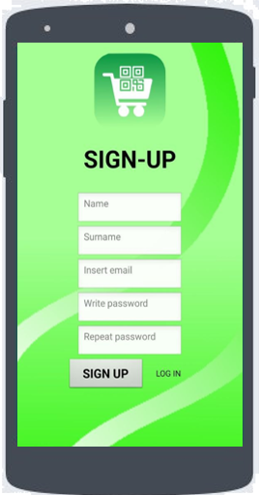
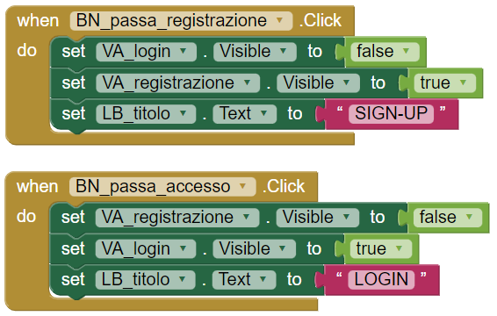
D1
D3
Requirement implementation: example
SCENARIO: A new user wants to sign up and then log in → R1 + R2
The screen remains the same,
but the user interface changes.
Here the user can fill out the registration form,
then send it through the "SIGN UP" button.

Slide 44
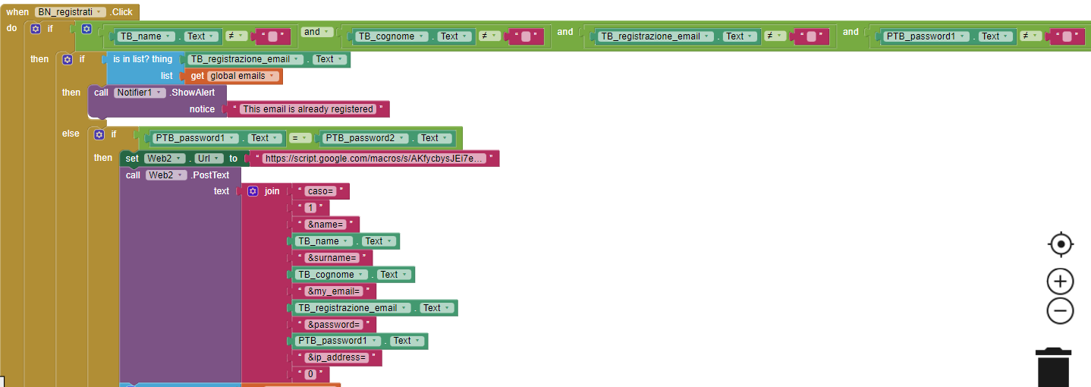
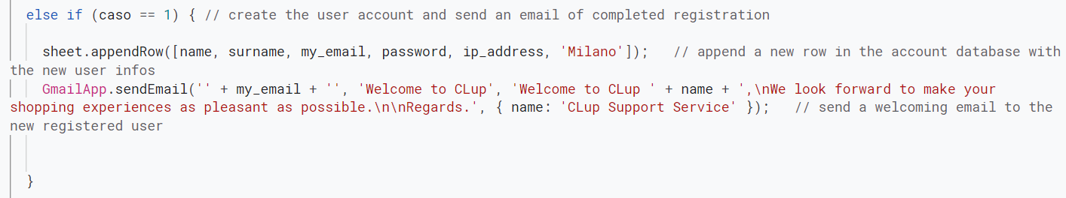
D1
D3
Requirement implementation: example
SCENARIO: A new user wants to sign up and then log in → R1 + R2
Before registering the user,
the app performs some checks:
1) All the form fields must be filled
2) The user must not be already
registered (email not in the DB)
3) The passwords must match
If all the controls are passed,
a new Web is set to call the script
dedicated to storing the new user
in the Account DB and a welcome
e-mail is sent.
Then, the screen comes back to the
login form.
Instead, if one of the controls fails,
an error message is shown.

Slide 45
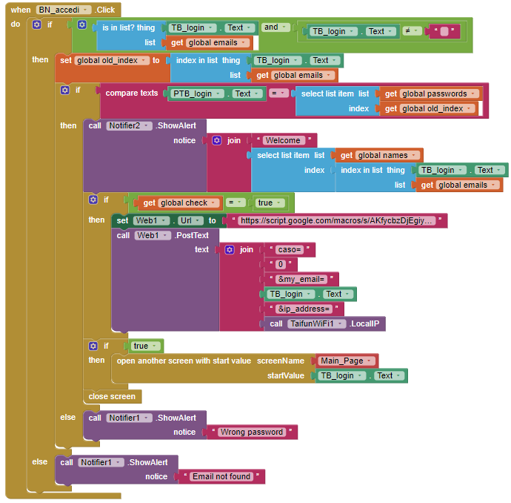
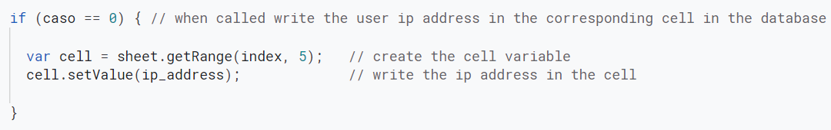
D1
D3
Requirement implementation: example
SCENARIO: A new user wants to sign up and then log in → R1 + R2
Now the user is registered and they can log in by inserting
their email and password.
Once the "LOG IN" button is pushed, the system first checks if
the email is actually inserted and if it is in the DB.
If also the password inserted is the one associated with the
given email, then the system opens the "main page" passing
as start value the email to keep track of the user account.
If, before making the access, the user ticks the "Remember me“
box, at the moment of the login a Web component invokes the
write Apps Script to store their device IP address for next time.

Slide 46
D4
TESTING
Testing Environment
Testing Methodology
Test case: example

Slide 47
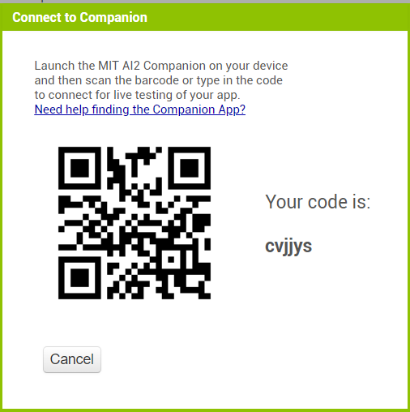
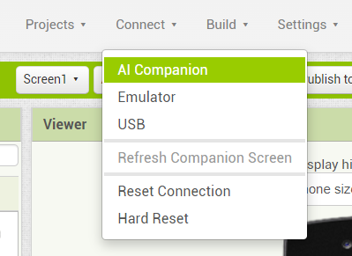
D4
Testing environment - AI companion
The first tests were conducted exploiting the “AI Companion” functionality present in the MIT App Inventor environment.
This function allowed us to perform live testing without the need to build and install a new application at each test.
At the end, the final tests were executed on the real built application.

Slide 48
D4
Testing methodology
Black-Box testing:
The chosen approach was a Black-Box testing conducted step by step during all the implementation phase, with the intention to verify at each step the right functioning of the application, also covering the cases of boundary values and wrong inputs.
White-Box testing:
At each detected error we proceeded performing debugging through White-Box testing directly on the App Inventor interface or the AppScript code.
At the end again Black-Box testing as confirmation of correction.

Slide 49
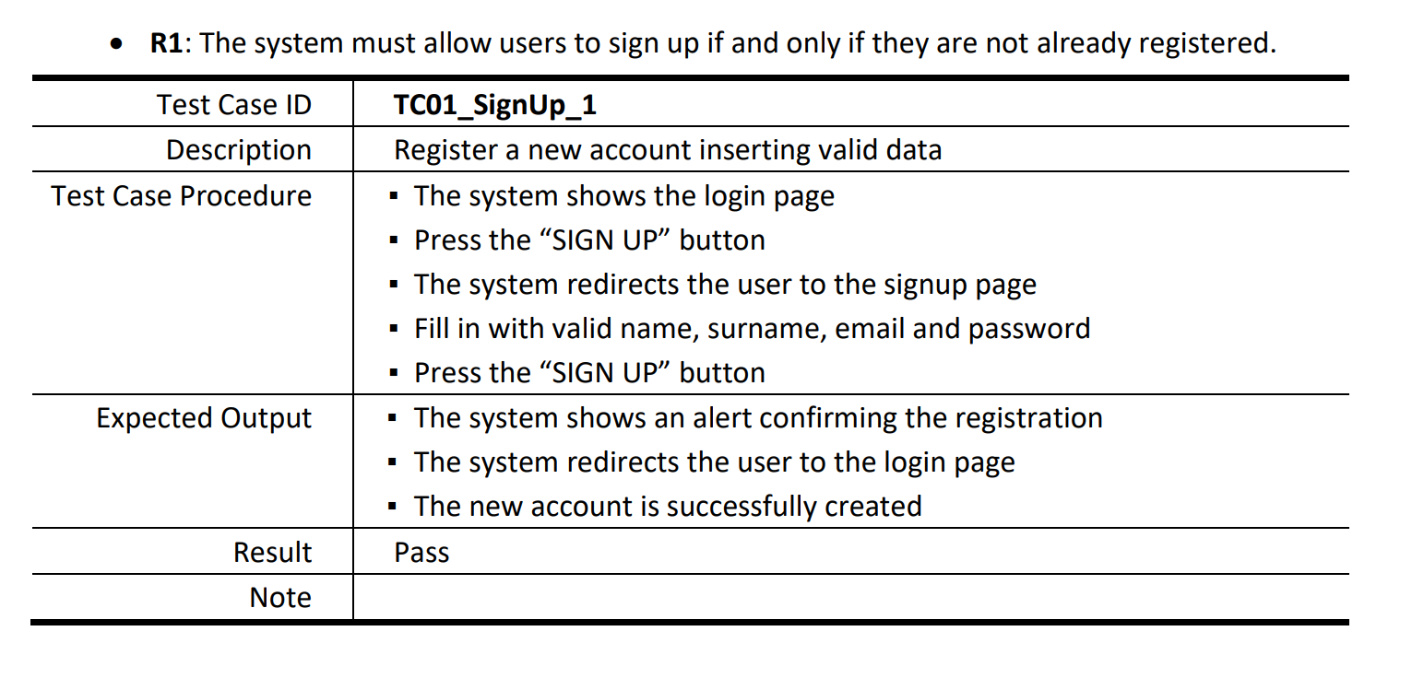
D4
Test case: example

Slide 50
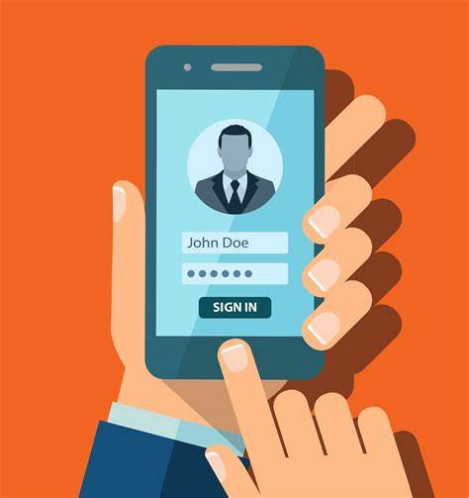
DEMO

Slide 51
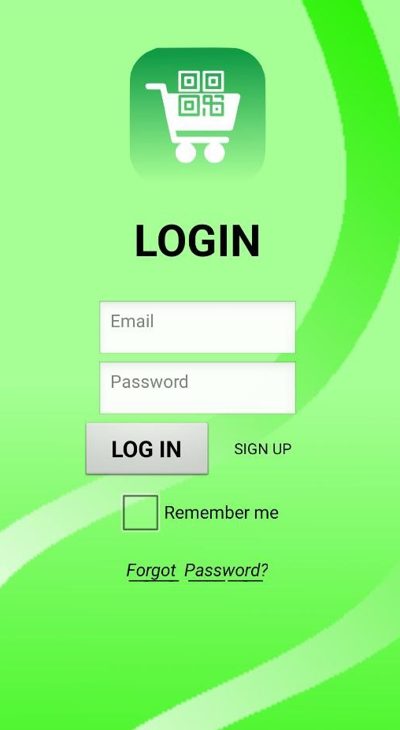
CLUP: HOME PAGE
LOG IN PAGE
Once the application has been open, the home page is shown. The user can log-in by uploading the correct credentials.
He can check the "remember me" box so as not to repeat these steps if the application is closed.
By pushing the “Forgot Password" button, the user will receive an email with the lost credentials.
If the user is new, he must first sign up

Slide 52
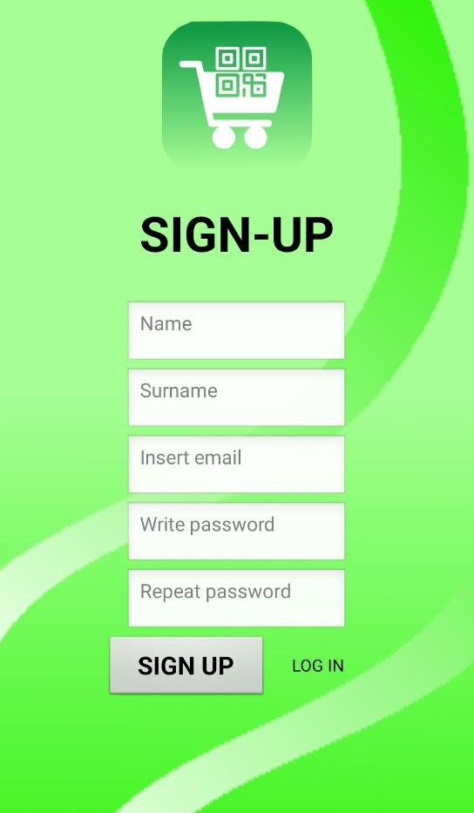
CLUP: REGISTRATION
SIGN UP PAGE
When the customer want to register to use the services of the app,
he must compile the sign-up form.
If the entered data are correct and if the user is not already registered, the process will be successful, and a confirmation email will be sent.
Then, he can log-in.

Slide 53
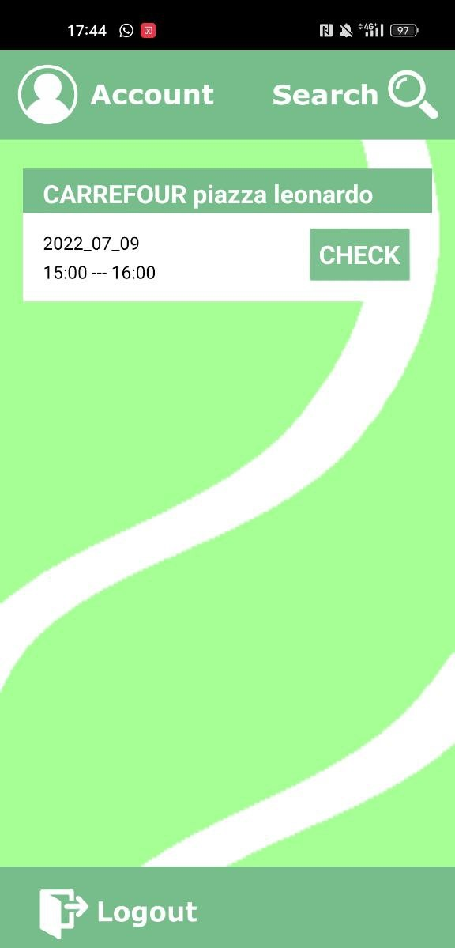
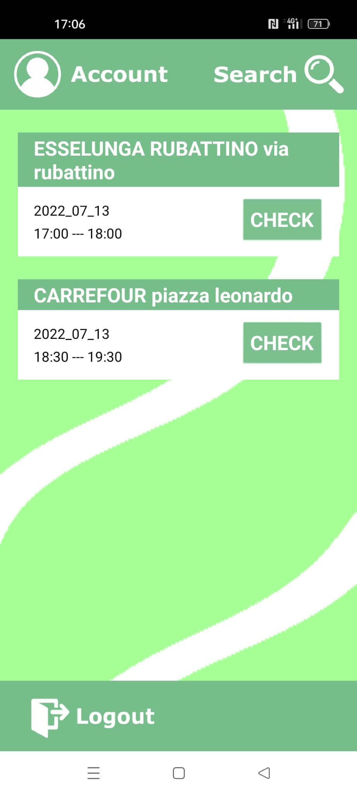
CLUP: SERVICES
MAIN PAGE
The logged-in user can take advantages of the app functions. He can check the current tickets or create a new one by pushing the “Search” button.
From the main page he can also open the User section by clicking on “Account”.
Once the user has finished the desired operations, he can log out.

Slide 54
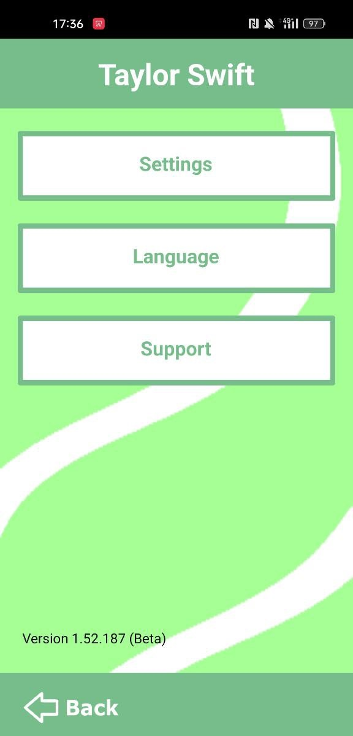
CLUP: SERVICES
USER PAGE
In the User page, the guest can update his personal credentials in the setting section or contact the Support.
In future developments, the user will be able to change the Language.
Once the operation are done, the user can come back to the Main page.

Slide 55
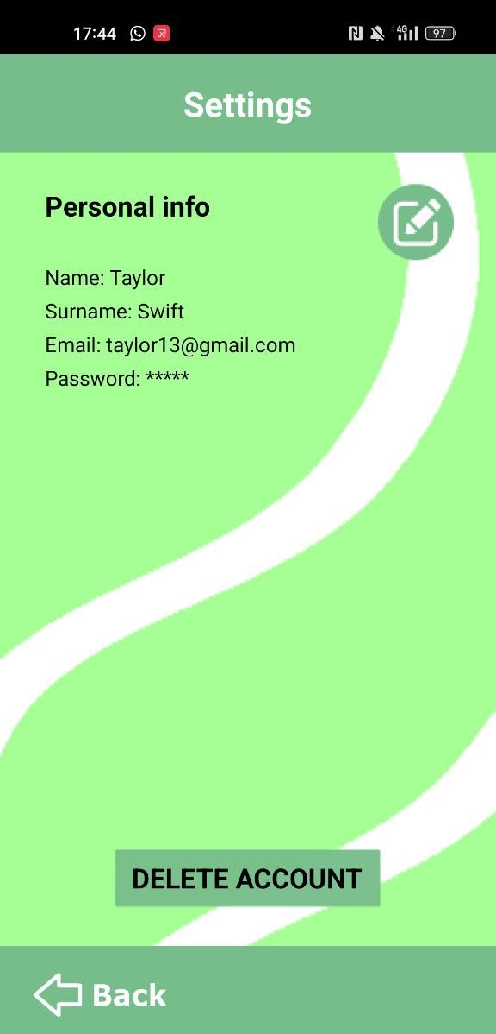
CLUP: SERVICES
SETTINGS PAGE
The User has the possibility to change the registered credentials or delete his account at any time.
To change the credentials, he must press the button at the top right.
Finally, he can come back to the User page.

Slide 56
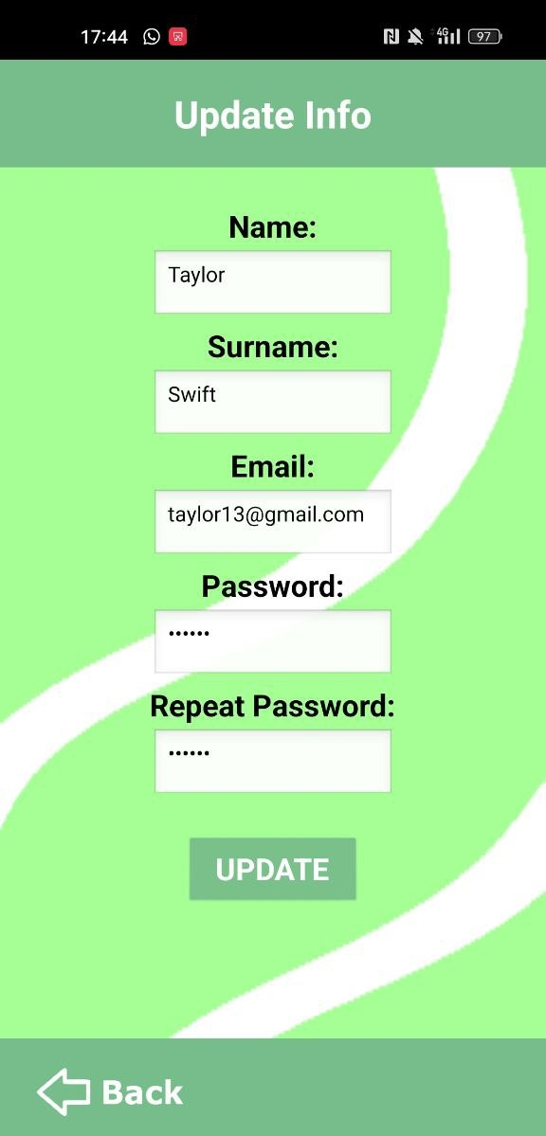
CLUP: SERVICES
UPDATE INFO PAGE
Here, the User, has the possibility to change Name, Surname, email or password.
The changed information will be saved once the key “update” is selected.
Once the operation is done, he push the “Back” button.

Slide 57

CLUP: SERVICES
SUPPORT SERVICE PAGE
In case of problems, the user can report an error.
By pressing the “send" button, the developers will receive an email with the specified problem description.
With the “Back” key, he returns to the User page.

Slide 58

CLUP: BOOKING
SEARCH SUPERMARKET PAGE
Once the Search page is opened from the Main page, the following screen is shown.
The user is automatically directed to the preferred city, but he can change it in any time thanks to the button located at the bottom right.
By pressing on "Supermarket name", a list of supermarkets appears;
at the same time, the user can digit to search for the desired market and the relative timetable.
With “Back”, the Main page appears.

Slide 59

CLUP: BOOKING
SEARCH CITY PAGE
The user can select a new city from a given list.

Slide 60


CLUP: BOOKING
MARKET PAGE
When the market is selected, the timetable is shown.
Here, the User can select the day and the time slots.
The User can also consult a legend by pressing on “?“.
He can also go Back to the Search supermarket page

Slide 61

CLUP: BOOKING
MARKET PAGE - legend
If the user is confused and cannot understand the meaning of the colors, he can consult the following legend.
This description can be closed with the button “X”.

Slide 62


CLUP: BOOKING
MARKET PAGE – slot selection
Once the slots have been chosen, two new buttons appear.
With “Clear”, the current selection is canceled.
With “Book”, the user is routed to the Booking confirmation.

Slide 63


CLUP: BOOKING
BOOKING CONFIRMATION PAGE
If the user is satisfied with the choices made, he can press “confirm”. in this case a new ticket is created and shown.
Else, by pushing “cancel”, the user comes back to the Market page with the selected slots.

Slide 64


CLUP: BOOKING
QR CODE
The QR code of a given ticket is shown in two cases, when the ticket has been created, or when the ticket has been selected.
Depending on the previous cases, the button “Back” can show the Market page or the Main page.
The user can also delete an existing ticket.

Slide 65
THANK YOU FOR YOUR ATTENTION

